Slide 1

Stock Market Prediction
Ning Chen

Slide 2
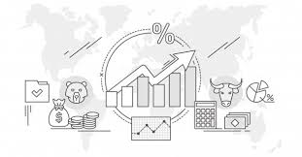
Stock Market Prediction
Overview
Business Understanding
Data Understanding
Data Preparation
Modeling
Evaluation
Deployment

Slide 3
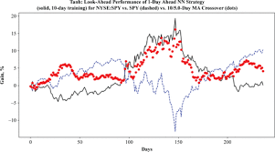
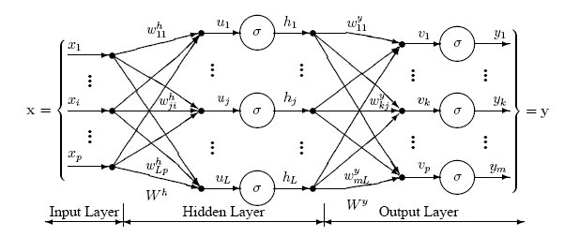
Overview
Accurate prediction of stock market asset is a significant and challenging task due to complicated nature of the financial stock markets.

Slide 4
Business Goals
Stock market prediction aims to determine the future movement of the stock value of a financial exchange.
Classification: Trade Strategy (buy sell hold)
random forest, SVM, Xgboost, NN
time series regression model: SARIMAX, Facebook Prophet, LSTM
sentimental analysis: NLP

Slide 5


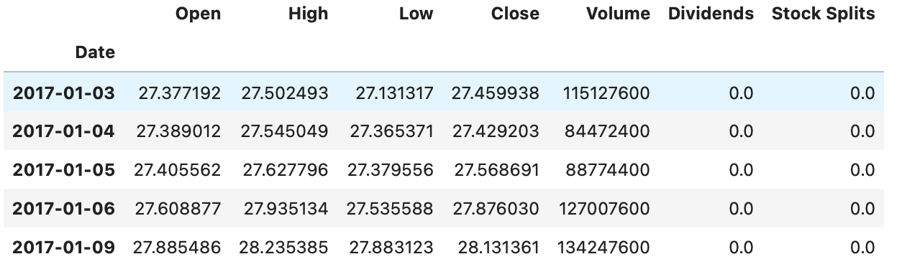
Data Understanding
IEX API and Yahoo Finance

Slide 6
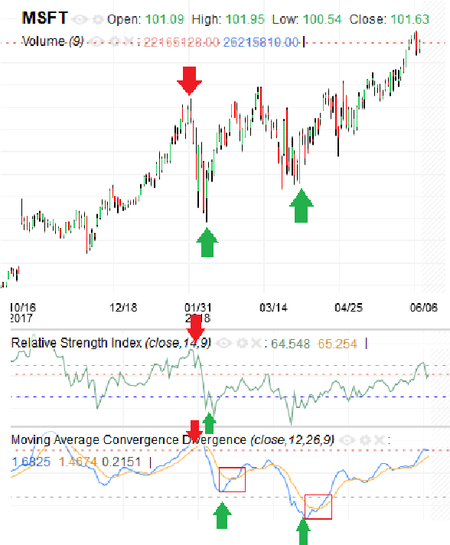
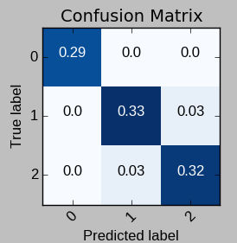
Data Understanding
Trade Strategy
local minimum to buy, local maximum to sell, other time to hold.
sell
buy
buy

Slide 7
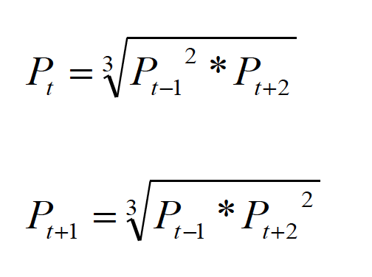
Data Understanding
Missing data
The fact that data are missing should not be neglected—quite often it is an indication of illiquidity. Using an average price results in an underestimate of volatility.

Slide 8
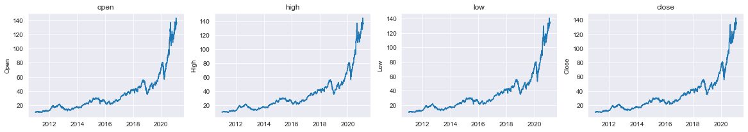
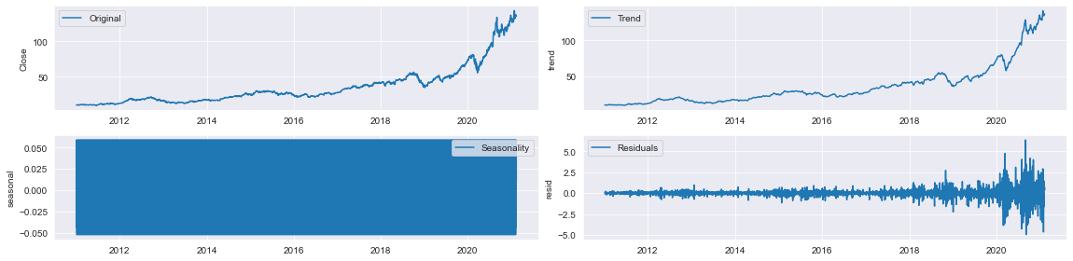
Data Preparation
seasonal decompose

Slide 9
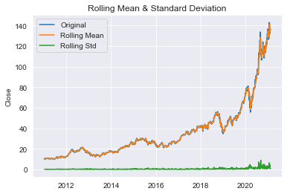
Data Preparation
Dickey-Fuller Test

Slide 10
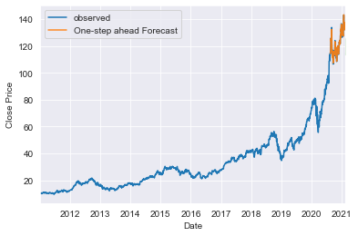
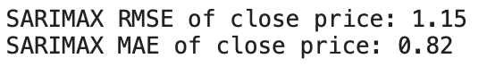
Modeling & Evaluation
SARIMAX Model with exogenous features

Slide 11
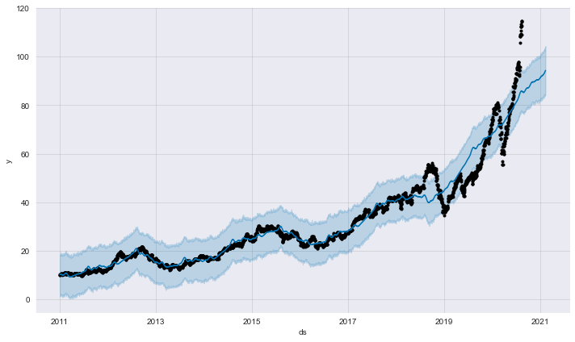
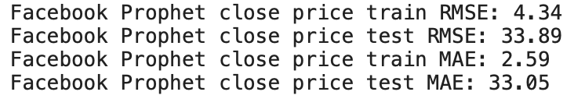
Modeling & Evaluation
Facebook Prophet

Slide 12
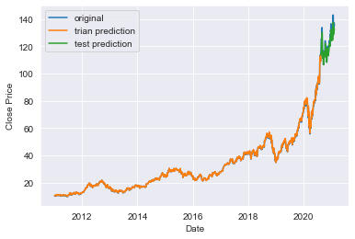
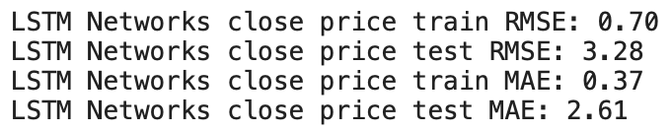
Modeling & Evaluation
LSTM

Slide 13

Next Step
accurate trade strategy modeling
more exogenous features
NLP
web app and phone app

